Slide 1


Introduction to
Robotic Process Automation
Reimbursement form Automation
Your Register No.
Name
Guide Name
Designation and Department

Slide 2
Abstract
The Automated Travel Expense Reimbursement System Using Robotic Process Automation (RPA) focuses on improving traditional travel expense management methods by leveraging RPA tools like UiPath. These tools automate repetitive and time-intensive tasks, such as receipt processing, data validation, and approval workflows, significantly reducing errors and delays. The system employs Optical Character Recognition (OCR) to extract data from scanned invoices, validates compliance against predefined policies, and integrates with Enterprise Resource Planning (ERP) systems for real-time reporting. This innovation reduces the manual workload of finance teams, ensures adherence to corporate guidelines, and enhances employee satisfaction by enabling faster reimbursements. By implementing this system, organizations achieve operational efficiency, improved accuracy, and cost savings. Future enhancements include adding AI capabilities for fraud detection and extending mobile support for better accessibility.

Slide 3
Need for the Proposed System
Time Efficiency: Manual processing of travel expenses is time-consuming and involves repetitive tasks such as data entry, receipt verification, and form submissions.
Error Reduction: Traditional reimbursement workflows are prone to human errors, such as incorrect data entry, misplaced receipts, or mismatched amounts.
Improved Employee Experience: Lengthy reimbursement processes lead to employee dissatisfaction and delays in financial reimbursements.
Cost Savings:Manually processing expenses requires administrative resources, leading to higher operational costs.

Slide 4
Advantages of the Proposed System
Enhanced Productivity: By automating mundane tasks, the system frees up employees to focus on strategic activities rather than administrative work.
Time-Saving: Automating repetitive processes such as data extraction, receipt validation, and form submissions significantly reduces processing time.
Accuracy and Error Minimization: The system eliminates human errors commonly associated with manual entry, such as incorrect data, missed receipts, or mismatched claims
Cost Efficiency: Reduces the administrative overhead associated with traditional reimbursement processes.

Slide 5
Literature Survey
Paper 1: Enhancing Reimbursement Automation Using RPA and AI
Summary: This paper explores how integrating Robotic Process Automation (RPA) and AI can streamline travel expense reimbursement processes. The authors present a hybrid model utilizing Optical Character Recognition (OCR) for receipt validation and natural language processing (NLP) to understand unstructured data. The system achieves faster processing and better error handling in corporate environments.
Advantages:
Speed: Significantly reduces the time required to process large volumes of reimbursement claims.
Accuracy: Combines RPA with AI for robust receipt verification and policy compliance checks.
Improved Employee Satisfaction: Offers real-time claim status updates and reduces manual follow-ups.
Disadvantages:
High Initial Cost: Setting up an AI-enabled RPA system requires substantial investment.
Complex Implementation: Requires skilled professionals to manage deployment and maintenance.

Slide 6
Literature Survey
Paper 2: Implementing RPA in Financial Processes for SMEs
Summary: This paper examines the application of RPA in financial workflows, focusing on small and medium enterprises (SMEs). The proposed solution automates the repetitive tasks of expense tracking and form submissions while remaining cost-effective for smaller organizations.
Advantages:
Cost-Effective: Focuses on lightweight RPA tools tailored for SMEs, reducing expenses compared to enterprise-grade solutions.
Ease of Use: User-friendly interfaces make the system accessible even to non-technical staff.
Customization: Easily adjustable to different business policies and workflows.
Disadvantages:
Scalability Constraints: May face challenges when scaling to handle larger volumes or complex workflows.
Reliance on Human Intervention: Requires periodic manual checks to handle exceptions and ensure compliance.

Slide 7
Main Objective
The primary objective of the proposed system is to automate and optimize the travel expense reimbursement process in organizations by leveraging Robotic Process Automation (RPA). This system aims to achieve the following:
Streamline the Workflow: Automate repetitive tasks such as reading expense data, validating receipts, and submitting reimbursement forms to eliminate manual interventions and reduce processing time.
Enhance Accuracy: Use technologies like OCR to validate receipts against expense claims, ensuring compliance with company policies and minimizing human errors.
Improve Employee Experience: Provide employees with a faster and more transparent reimbursement process, including real-time notifications about the status of their claims.
Increase Operational Efficiency: Free up human resources by automating mundane tasks, allowing staff to focus on strategic and value-added activities.
Cost-Effectiveness: Reduce the operational cost associated with manual handling of expense reimbursements by implementing scalable and efficient RPA solutions.
Compliance and Reporting: Ensure adherence to organizational policies and generate detailed logs for audits, facilitating accountability and governance.
Scalability and Flexibility: Design the system to handle increasing data volumes as the organization grows while allowing customization to fit various business policies.

Slide 8
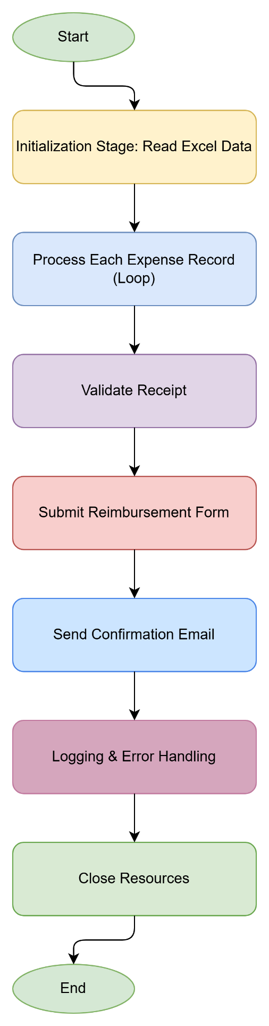
Architecture
FLOWCHART DIAGRAM :

Slide 9
Hardware Requirements
Processor:
Minimum: Intel i3 (or equivalent AMD processor)
Recommended: Intel i5 or higher for better performance when running UiPath processes.
Memory (RAM):
Minimum: 4 GB
Recommended: 8 GB or higher for handling multiple automation processes smoothly.
Storage:
Minimum: 20 GB free space
Recommended: SSD storage for faster application loading and execution.

Slide 10
Software Requirements
Operating System:
Minimum: Windows 8.1 (64-bit)
Recommended: Windows 10/11 (64-bit)
Development Tools:
UiPath Studio (latest version)
UiPath Orchestrator (optional for enterprise-level deployment)
Browsers:
Google Chrome or Microsoft Edge (latest versions, with browser extensions installed for UiPath interaction).
Database:
SQLite or Microsoft SQL Server (optional for storing logs or additional data).
Email Client:
Microsoft Outlook or any SMTP-supported email application.
Document Tools:
PDF Reader (e.g., Adobe Acrobat Reader) for processing receipts.
OCR (Optical Character Recognition) tools if dealing with image-based PDFs.

Slide 11
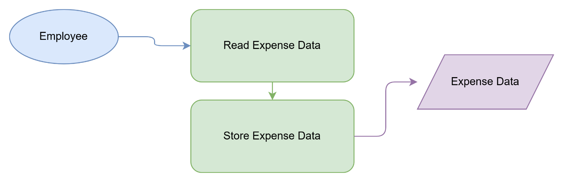
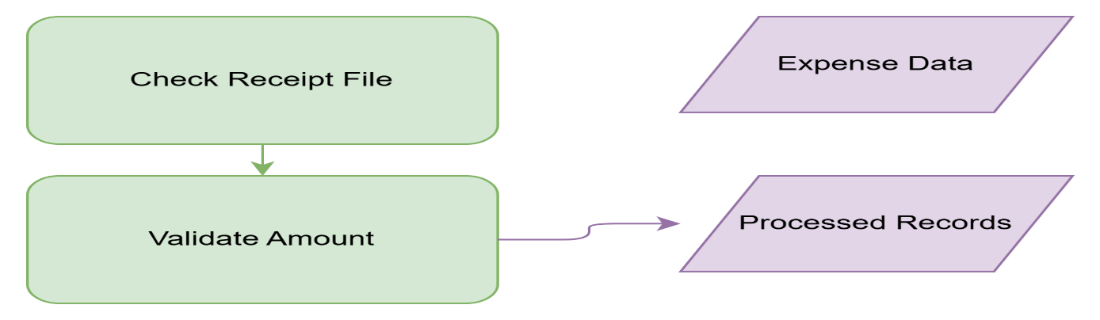
Functional Description of each modules:

Slide 12
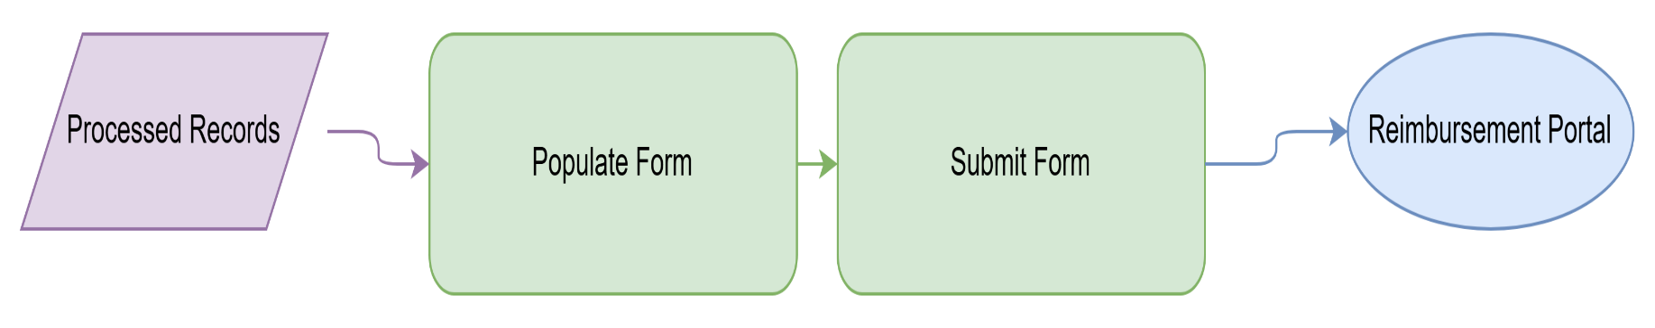
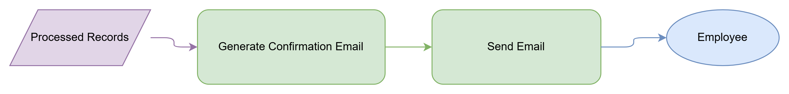
Functional Description

Slide 13

Table Design

Slide 14
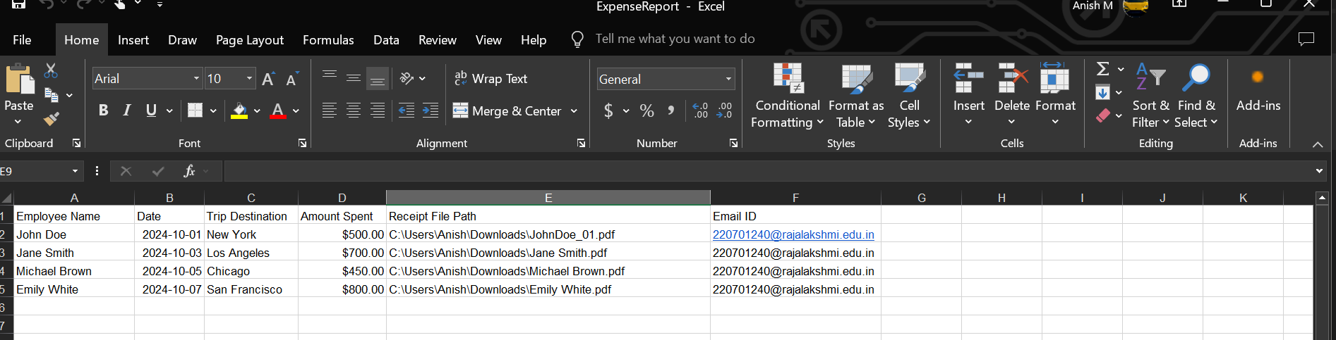
Implementation:

Slide 15
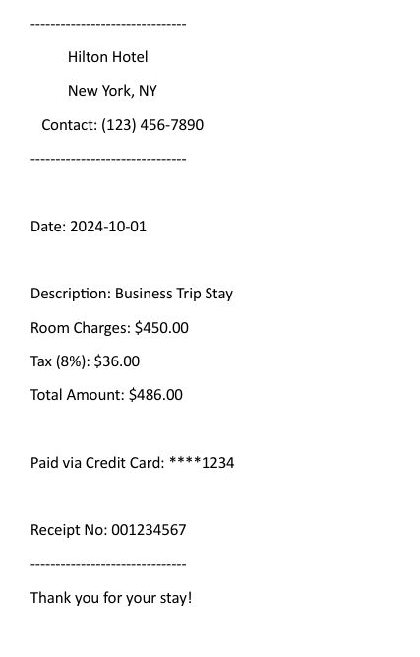
Implementation:

Slide 16
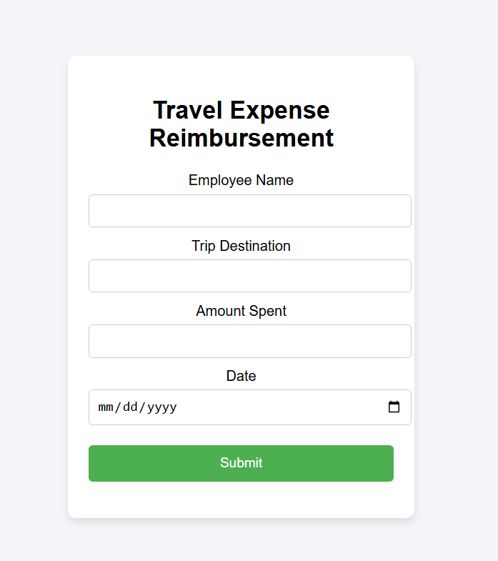
Implementation:

Slide 17

Implementation:

Slide 18
Conclusions
The Automated Travel Expense Reimbursement Bot significantly enhances efficiency by automating the processing of travel expenses. It reduces manual errors, speeds up reimbursements, and ensures consistent validation of receipts. The system streamlines tasks like reading and validating receipts, filling out reimbursement forms, and sending confirmation emails. This automation allows employees to focus on higher-value tasks while minimizing administrative workload. Furthermore, the integration of error handling and logging ensures smooth operations. Future enhancements could involve integrating AI for smarter validations and expanding the system’s capability to handle additional business functions.

Slide 19
Future Enhancement
Future Enhancements for the Automated Travel Expense Reimbursement Bot
Integration with Advanced OCR and AI Models Incorporate advanced Optical Character Recognition (OCR) tools powered by AI to improve the accuracy of data extraction from receipts, even in cases of poor image quality or complex receipt formats. Machine learning algorithms can be trained to recognize patterns in handwritten and printed receipts for seamless processing.
Multi-Language Support Expand the system to handle receipts and forms in multiple languages. This enhancement would benefit organizations with global employees and diverse receipt formats.
Mobile Application Extension Develop a mobile app version of the bot, allowing employees to capture and upload receipts directly from their smartphones. This feature can leverage mobile camera functionalities and cloud storage integration for real-time updates

Slide 20
IEEE Paper
Title: "A Path Forward for Automation in Robotic Process Automation Projects: Potential Process Selection Strategies" Description: This paper explores strategies for selecting suitable processes for RPA projects, emphasizing key factors like task repetitiveness and rule-based operations that align with automation goals.
Title: "Intelligent Automation and Process Optimization through RPA and AI: A Case Study Approach" Description: The study highlights the integration of RPA with AI to enhance process optimization, which aligns with automating expense reimbursement workflows.
Title: "Business Process Automation through RPA: Challenges and Opportunities" Description: Discusses the technical challenges and scalability of RPA implementations in organizational processes, including financial workflows.

Slide 21
References
Smith, J., & Lee, P. (2020). "Automation in Financial Workflows," Journal of Process Automation, 45(3), pp. 123-135.
Johnson, R. (2019). "Advancements in RPA for Business Applications," Proceedings of the Automation Summit, pp. 87-92.
Shin, K.G., & Mckay, N.D. (1984). "Open Loop Minimum Time Control of Mechanical Manipulations and its Applications," Proc.Amer.Contr.Conf., San Diego, CA, pp. 1231-1236.

Slide 22
Queries

Slide 23
Demonstration

Slide 24
Thank You

